Slide 1
Autonomous Vehicle Lane Density

Slide 2
Main Scenario
Pre –Conditions
1. User has to add vehicles on their own using Add option
2. Once the vehicle is added click on start or you can start and then click on Add vehicle

Slide 3
Trigger
Once you start the application you will be able to see the simulation on the main panel

Slide 4
Post-Conditions
Success-end condition – You could see the vehicle moving on the lanes and you can modify certain changes for the vehicle using the available options
Failure –end condition – If there is any issue in the code then vehicles will move ambiguously. If you click simultaneously without any delay then two vehicles might overlap
Minimal Guarantee – Vehicles are running perfectly fine on all 3 lanes

Slide 5
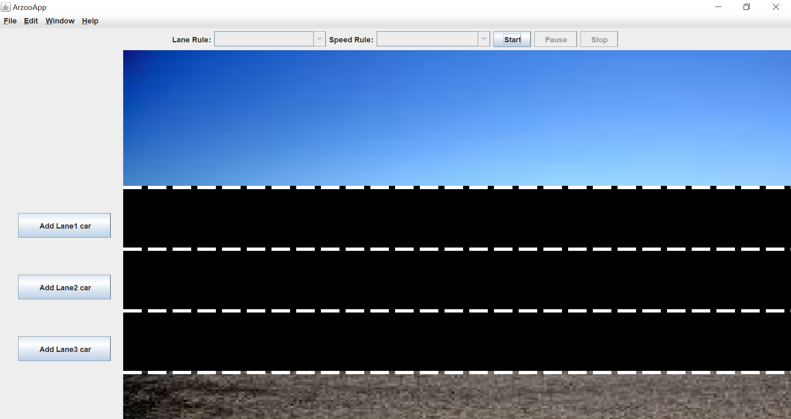
Main Scenario My AVL app and rules consists of 1. Add cars to Lane 2. Change lane of the car 3. Change speed of the car 4. Start button to start the cars moving 5. Pause button to pause the movement of the car 6. Stop to stop the movement and refresh the panel with new panel when you start all over again and enable start again

Slide 6
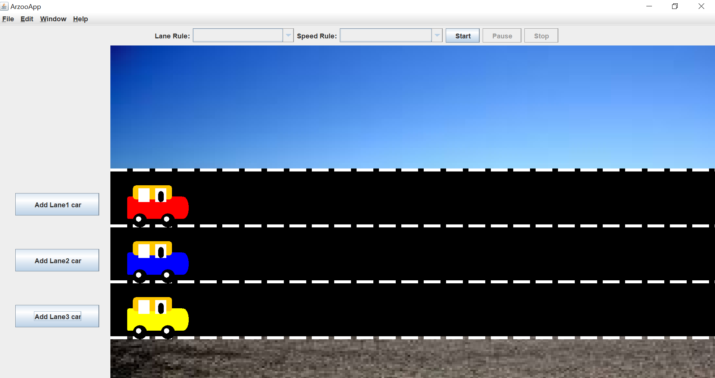
Adding vehicles on Lane 1, Lane 2 and Lane 3 using Add Lane Jbutton. Lane Rule and Speed Rule are disabled right now because we have not yet started the thread

Slide 7
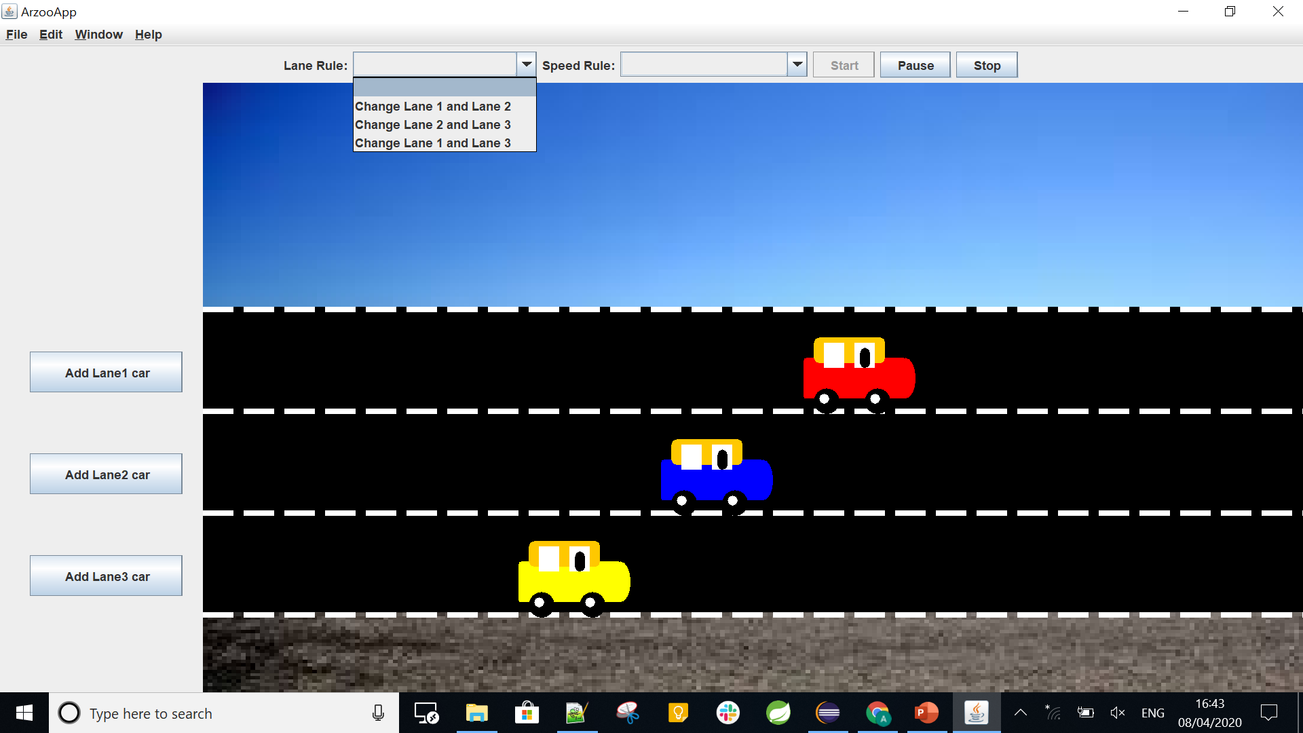
Every lane respective vehicle has been set a fixed speed. Lane 1 is the fastest, lane 2 moderate and lane 3 is the slowest of all. Once we click on Start button the thread starts to move and rule button are enabled. We can change the lane or speed of the cars now

Slide 8
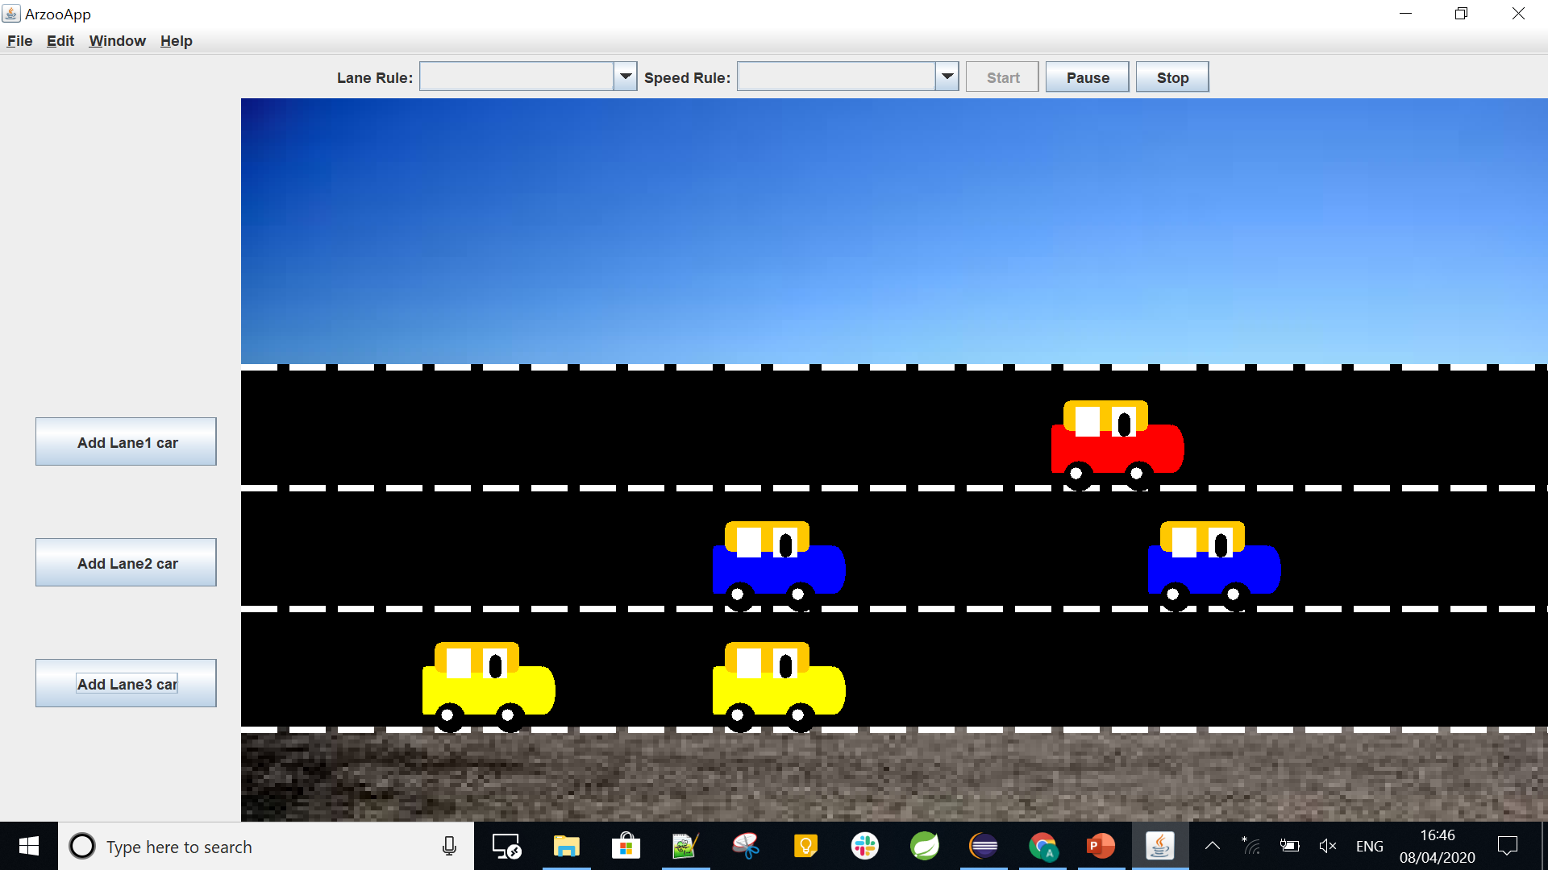
We can also add multiple cars to each lane during the process

Slide 9
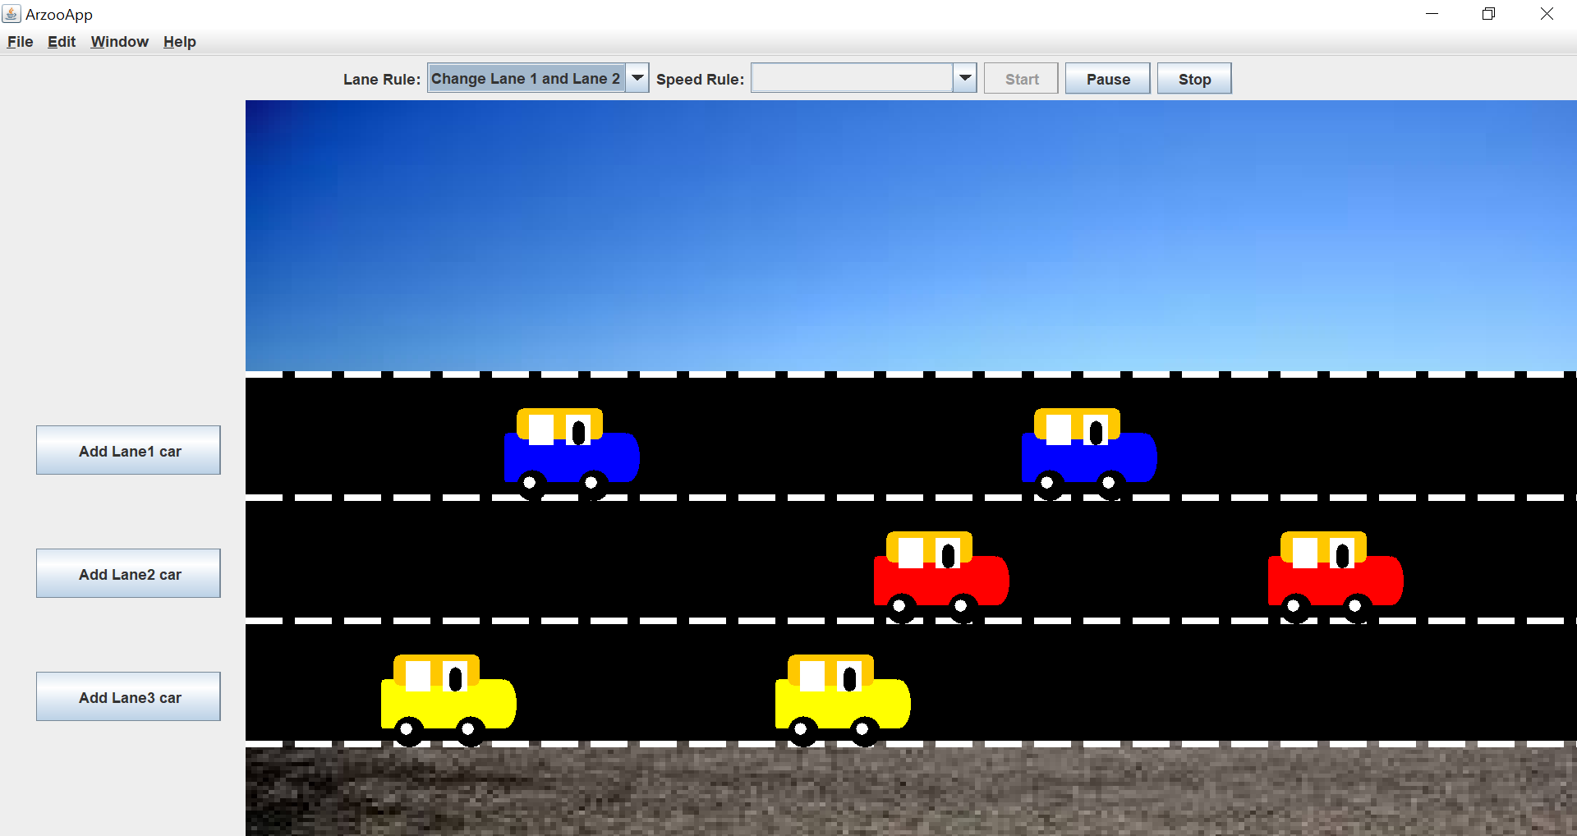
Changing cars of lane 1 and lane 2 using the Lane Rule drop down. You can change it either when it is moving or paused

Slide 10
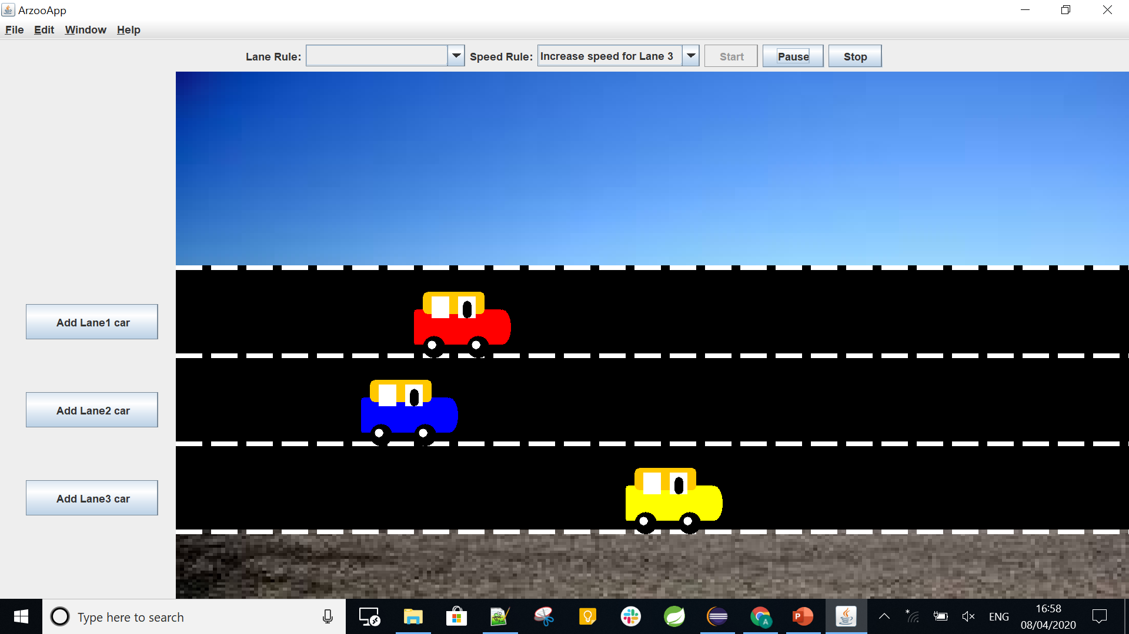
Similarly we can change the Speed of cars for a given lane using the speed rule dropdown. Over here the speed of the vehicle for respective lane is fixed and it will be increased and decreased accordingly. On every click of speed rule – it increase speed by 40 units (random visible number) and on every click of decrease option, it will decrease speed by 40 units Over here I have made cars of 3rd lane fastest which was slowest before

Slide 11
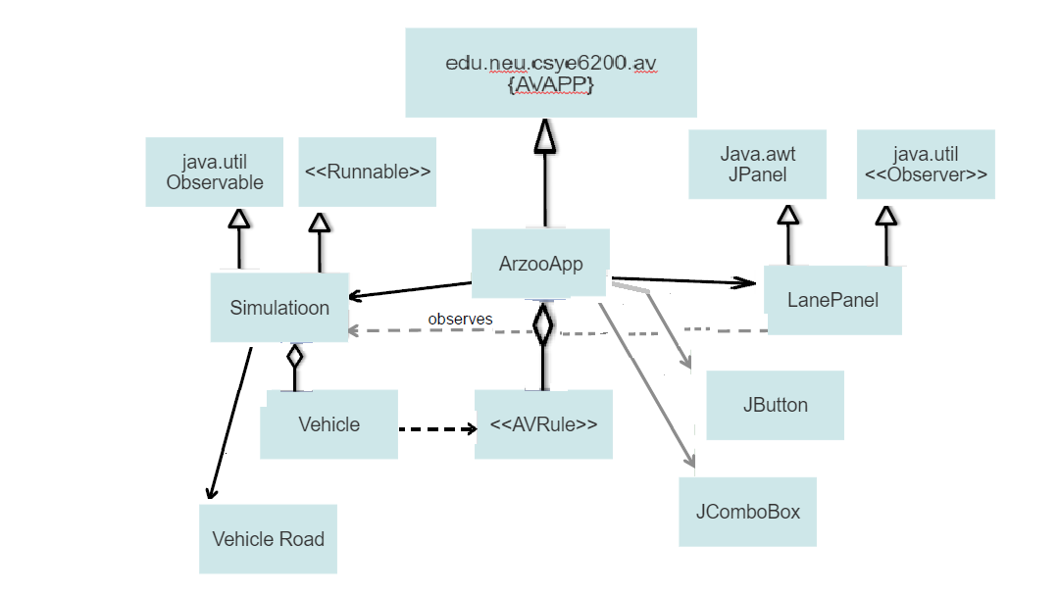
Sequence Diagram UML Diagram – Arzoo Uzma Neu Id - 001447452

Slide 12
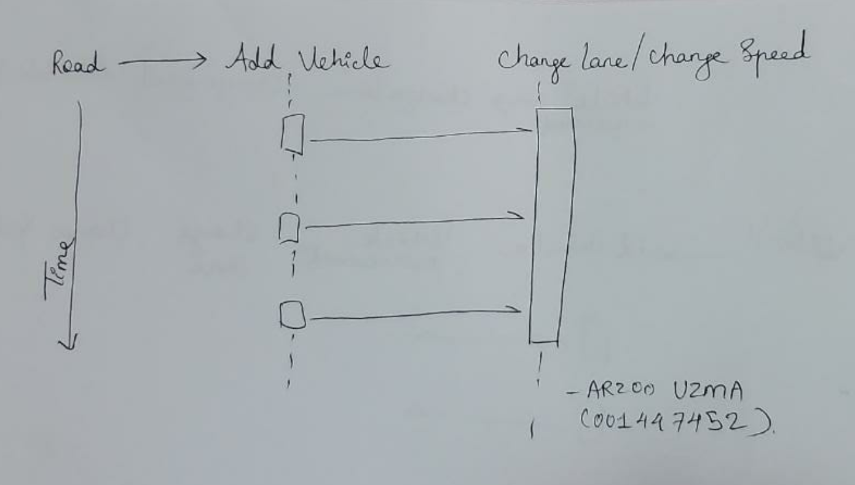
Sequence Diagram

